Slide 1


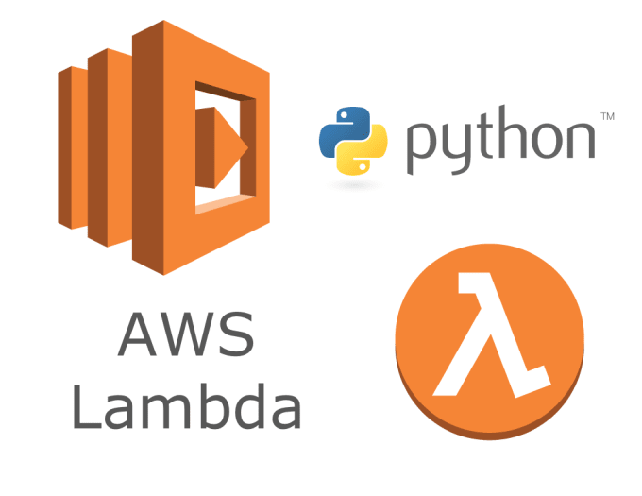
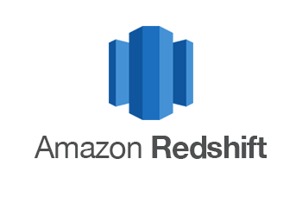
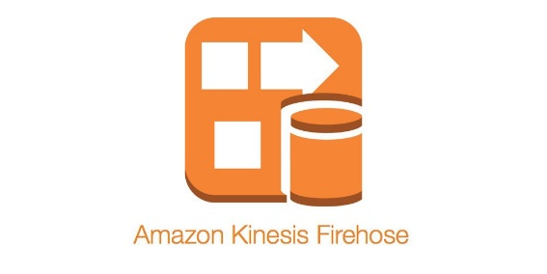
High level architecture
Data source
This can be any streaming solution, like Kafka etc.,
Basically this can grow in demand and emit the data generated to Amazon S3
This can scale in terms on number of files/objects and volume we would like to place. Can serve as a Data Lake on a longer run, ie., if we want to analyse any other events generated, go there pick the old files with new lambda and load the results to OLAP db.
This can scale and process the files as soon as it arrives. Load the result straight to Redshift or emit to a different folder in S3 and can be loaded to Redshift with a different Lambda
We could run a smaller cluster in the beginning, and as the data grows can move to bigger cluster. There are quite a lot of alternatives in this layer. We could use any MPP/ OLAP systems to build data-mart or warehouse.
Like Snowflake Cloud etc.,

Slide 2
Little bit about scaling requirement
We could use Streaming data services like Kinesis which is fully managed, otherwise can create a Kafka cluster etc.,
Build a data-lake in AWS S3 or in Azure/GCP.
Use server less for transforming the data. Otherwise, could build a Kubernetes cluster, deploy docker containers for data engineering. Which can scale to massive compute as needed.
Finally load the transformed data into Cloud based OLAP MPP systems, which can scale as the data grows. Also can be compatible to connect/support a variety of end-user reporting tools.

Slide 3
Little bit about the python program
Assumed “We say a user is active if the engagement time is at least 3 seconds and any valuable events occurred at least once.” each line is a valuable event. Not sure if you meant any other element with in the events.
The data load is done straight to the db with individual inserts just to prepare the desired outcome, but this is really an expensive operation. Instead the transformed output could be loaded/copied/imported into the tables. Once the initial transformed data is staged into a table, could kick start a ELT process with-in the db to prepare the report.
Its really a quick work in python, I have not done a lot of error handling case by case, so apologise for that.

